Slide 1
Design of Plant health prediction application
Senior Design 1
Timothy Riley Jr

Slide 2
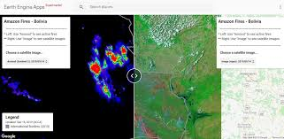
Introduction
This project will be the development of a web application in Google Earth Engine that performs plant health predictions on satellite images with implementation of a machine learning algorithm. Displaying concentrations of Biomass and % nitrogen from satellite imaging.
Figure 1. Displays example Web Application powered by Google Earth Engine.
Reference: https://luciovilla.users.earthengine.app/view/monitoring-amazon-fires

Slide 3
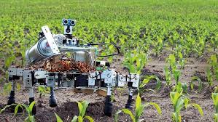
Background
-Agriculture today is conducted in a vastly different way than in the previous decades. New technology has taken full effect within the industry and provides and means of highly efficient production.
- With the rise in the application of artificial intelligence technologies in multiple industries globally, it is beginning to make its mark in the agriculture industry as well.
-With the help of AI, farmers can now analyze a variety of things in real time such as weather conditions, temperature, water usage or soil conditions collected from their farm to better inform their decisions.

Slide 4
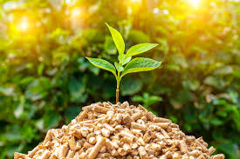
Background
Biomass
Biomass is the weight of living plant material contained above and below a unit of ground surface area.
Higher biomass content = healthier plant life
Nitrogen
Nitrogen is a key component of chlorophyll and directly affects photosynthesis.
Quantized by % present in soil

Slide 5
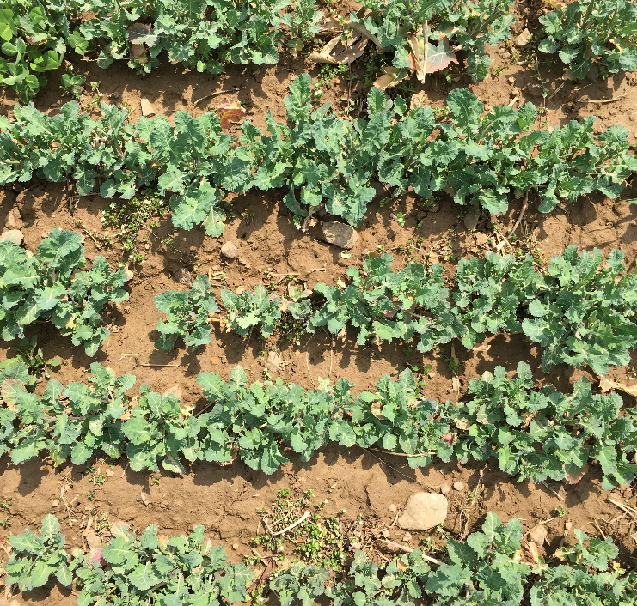
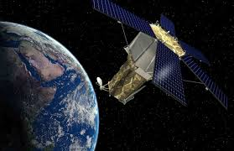
Motivation
It is well known by Agriculturists (farmers) that cover crops enhance the quality of crop production. One of the important benefits of cover crops is their impact on soil nitrogen cycling.
Many research projects are underway on this topic by multiple agencies such as the USDA. the Demand for sensing and analyzing the data needed for the topic is very high but difficult to achieve due to the large scale on which farm/ field sites operate.
Satellite image processing has become significantly improved and accessible in the recent years. This has lead to its ideal use in applications that analyze large regions of geographical data.

Slide 6
Objective
To deploy a web application through Google Earth Engines (GEE) API that analyzes satellite images and produces raster mapping of plant health, in the form of biomass content and percent nitrogen predictions.

Slide 7
Design Requirements and Constraints
Requirements
Perform regression on pixels to obtain predictions of biomass & nitrogen content with at least 90% accuracy
Access satellite images from coordinate inputs.
Display results of biomass and nitrogen content as a raster map layer on top in the Earth Engine API
Provide an interactive user interface with the Satellite Map
Constraints
Web application must be written in Google earth engine.
Accessible data is determined by images taken by the constellation of Sentinel satellites (Googles dataset) and field data taken from field sites by USDA
Pixel resolution of sentinel images is accurate down to 10 m by 10 m area.

Slide 8
System Features and Functionality
The system is a Web application accessible via web browser and served through Google’s Cloud Computing services.
The User Interface for the application is accessed through a custom Google Earth Engine link
The User interface will show the most recent imaging from the Sentinel II satellite and will have a prompt asking for a location.
Once ‘Run’ button is activated the satellite images will be processed by the application and utilize the trained ML algorithm to obtain predictions on biomass and nitrogen content
That vector data is transferred to raster mapping and presented to the UI for the user to evaluate.

Slide 9
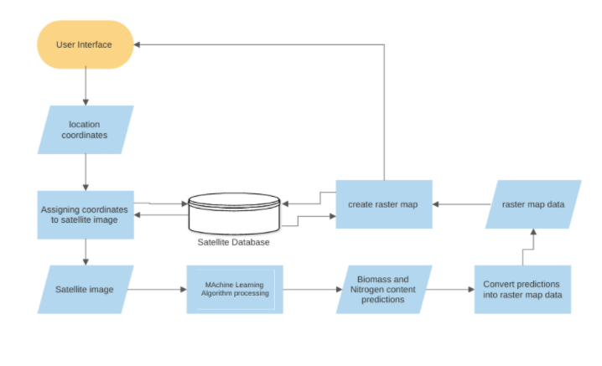
System Diagram

Slide 10
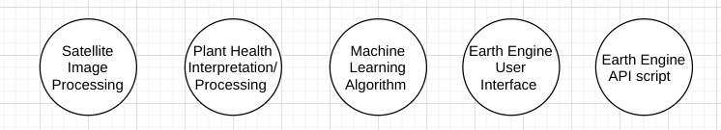
Design Approach
The First step: analyze and organize the training data.
The Second step: write the source code for an Alpha version of the Google Earth Engine app.
The Third step: preprocess the data into training and validation datasets for Tensorflow.
The fourth step: build and train a machine learning model in Tensorflow with the dataset.
The fifth step: improve model accuracy
The sixth step: add backend integration to the application.
The seventh step: improve the User interface code and workflow of the application.
Achieving proper functionality from the application system can simplified into ensuring these 5 major technical processes operate correctly and uniformly.

Slide 11
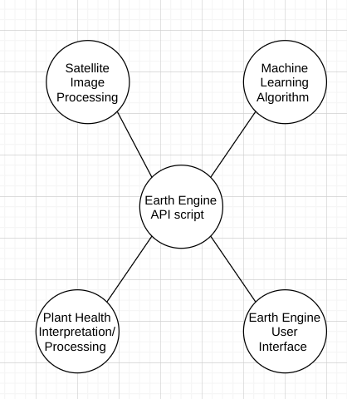
Implementation Introduction
As stated before the design of this application is dependent upon the successful functionality of 5 major technical processes.
Satellite image interpretation
Plant health interpretation
Machine Learning Algorithm
Earth Engine User Interface (UI)
Earth Engine backend script
The first 4 processes hold code that should be able to function outside of the completed system. The last is essentially the glue of the system.
Each major task implemented helps a specific technical process towards compatibility and integration within system as a whole
Fig. Conceptual link between technical areas

Slide 12
Implementation Plan
Task 1. Preprocessing the Dataset
Subtask 1. isolate necessary information from satellite
Subtask 2. isolate vital information from field site data
Subtask 3. Correlate quadrat data to pixel location in satellite images
Subtask 4. Build Dataset input pipeline
Task 2. Produce Machine learning Model
Subtask 1. Build Model structure & begin initial training.
Subtask 2. Collect results, revise and retrain the network.
Task 3. Develop Alpha-Application in GEE
Subtask 1. Build UI that accesses Sentinel - II satellite images
Subtask 2. Add coordinate location functionality
Subtask 3. Add image capture functionality

Slide 13
Implementation Plan
Task 4. Backend Development
Subtask 1. Preprocess the captured image for compatibility to network input
Subtask 2. Integrate the trained neural net model into the GEE API
Subtask 3. Write code to associate prediction output values with satellite image pixel locations
Task 5. Frontend
Subtask 1. Convert Biomass and Nitrogen % predictions to Raster Map data values
Subtask 2. Write code to Draw Raster map over satellite image
Subtask 3. Build User Interface for interaction with the Raster map
Task 6. Testing and Refinement
Subtask 1. Test the operability of the application and its ease of use
Subtask 2. Refine the Apps use and workflow

Slide 14
Tools and services used in implementation
Google Earth Engine: a cloud-based platform for planetary-scale environmental data analysis.
Google Collaboratory: Colab is a free Jupyter notebook environment that runs entirely in the cloud.
Tensorflow: a Python-friendly open source library for numerical computation that makes machine learning faster and easier
Python: an interpreted, object-oriented, high-level programming language with dynamic semantics.
Javascript: is a scripting or programming language that allows you to implement complex features on web pages.

Slide 15
Implementation of Task 1
Task 1 is vital to the training of the machine learning model
Dataset information was obtained from USDA operatives conducting research on quantifying cover crop abundance and other metrics in various fields.
plant health metric data:
5 field sites
3 treatments per site
8 quadrats per treatment
-data sampled twice for each quadrat
-each quadrat is 0.5 m by 0.5 m - data sampled is of biomass and nitrogen
satellite imagery data:
5 field sites
7 field geometric outlines
pixels per polygon to be determined
The satellite images analyzed in Google Earth Engines API through the Sentinel -2 surface reflectance image database.

Slide 16
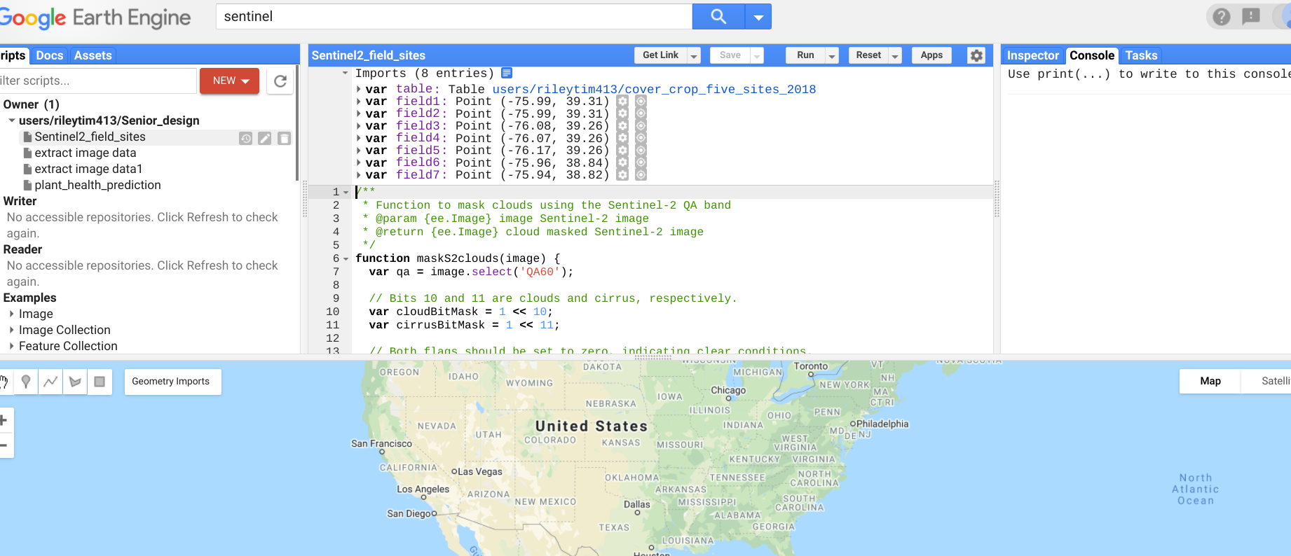
Implementation of Subtask 1.1
The open source coding platform Earth Engine allows for free extensive use and manipulation of satellite imagery from petabytes of satellite image datasets all accessible from their remote databases.
The API for the online code editor is in Javascript programming language.
Reading and understanding the operation of the Earth Engine IDE was critical in manipulating the satellite image data properly

Slide 17
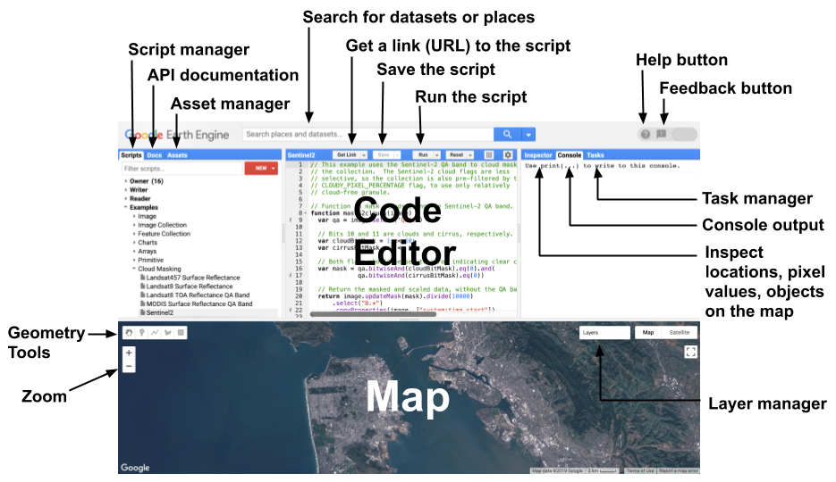
Implementation of Subtask 1.1

Slide 18
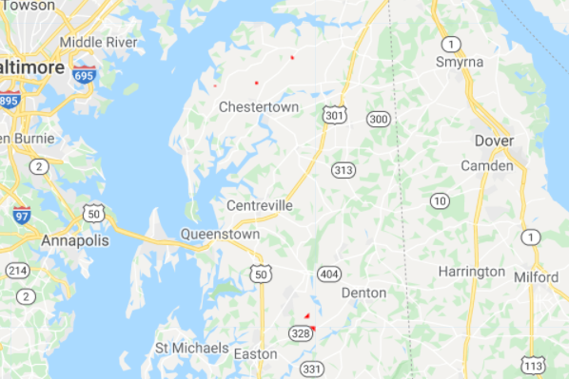
Implementation of Subtask 1.1
Satellite imaging data originally in the form of field boundary shapefiles
Shapefiles were loaded as assets ito the Code editor IDE
Imported to the script as a Feature collection
Initiated a render of the field sites as a new Map layer.

Slide 19
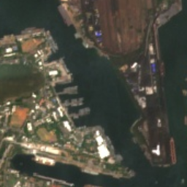
Implementation of Subtask 1.1
The Sentinel -2 satellite is wide-swath, high-resolution, multi-spectral imaging mission supporting Copernicus Land Monitoring studies, including the monitoring of vegetation, soil and water cover, as well as observation of inland waterways and coastal areas.
The Sentinel-2 MSI surface reflectance image assets contain 16 spectral bands.

Slide 20
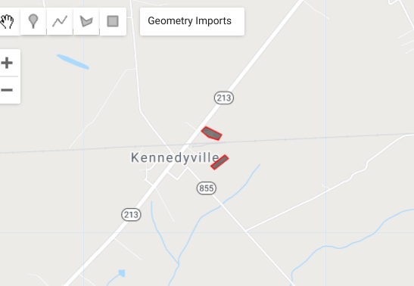
Implementation of Subtask 1.1
Imported satellite imagecollection data & analyzed.
Data was filtered to import 6 months of imaging.
Map layer for the data was produced then clipped to the region of the field site geometry

Slide 21
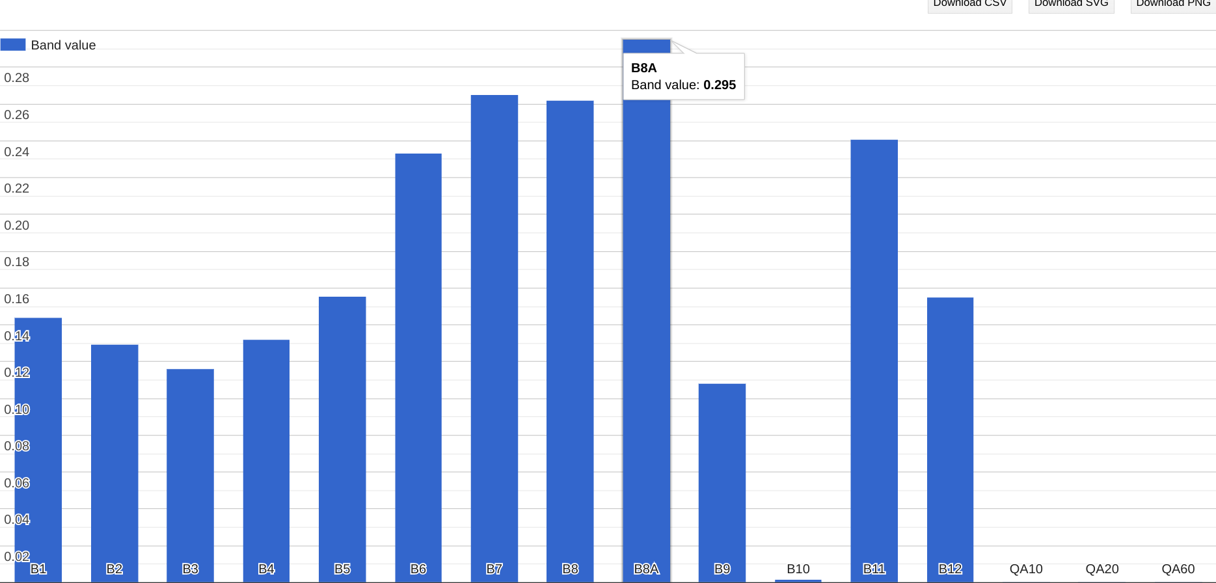
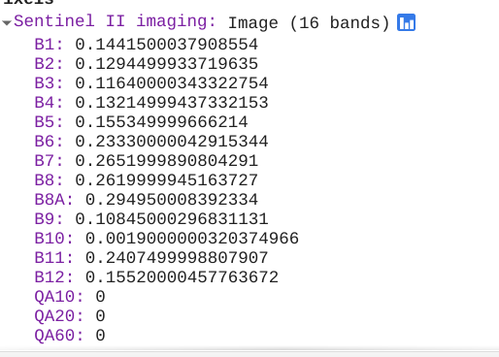
Implementation of Subtask 1.1
Images in EE are represented as a stack of georeferenced bands each with their own mask projection and resolution.
Image pixels hold values of each band taken at that specific coordinate.

Slide 22
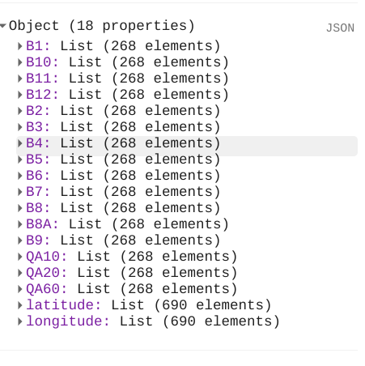
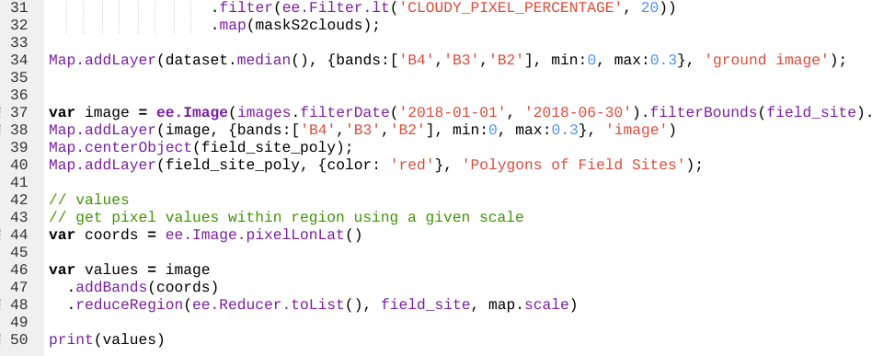
Implementation of Subtask 1.1
Band metadata for each pixel can be printed as an array (input for ML algorithm)
Next step was to extract the .json dictionary file

Slide 23
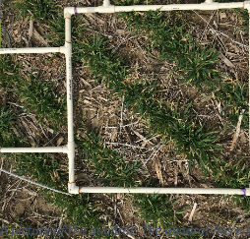
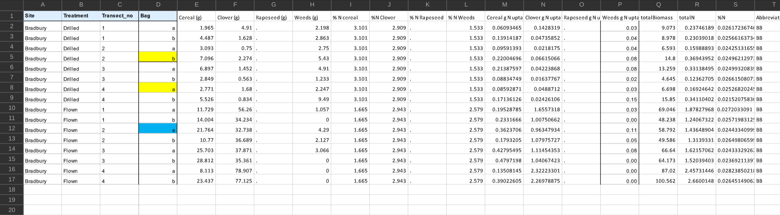
Implementation of Subtask 1.2
Field level data of biomass and nitrogen content was taken from various quadrats in each field site.
Metadata was transferred into excel datasheets.

Slide 24
Implementation of Subtask 1.2
Openpyxl is a python library for manipulating excel spreadsheets
A complication that arose was that the field level data taken from the various quadrats were not the most efficient to scale.
USDA contacts are currently recapturing the field level metadata for the fields at a larger scale with more exact coordinate data
Expected process completion midsummer

Slide 25
Implementation of Task 3
Task 3 is the beginning of writing the code for the app functionality.
The app will be written and published within the Earth Engine Javascript API.
The most basic functionality of the application are the objectives of task 3.

Slide 26
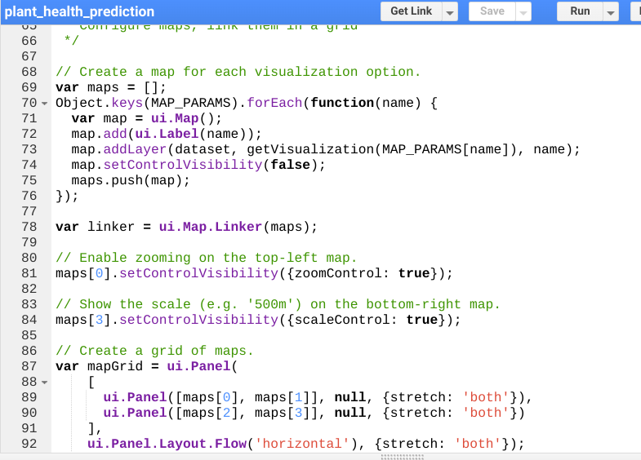
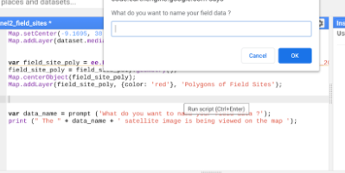
Implementation of Subtask 3.1
-The earth engine javascript API comes equipped with libraries of functions that perform native Javascript actions as well as functions to analyze, interpret and process geospatial raster and vector data.
-Prompts produced by native Javascript commands allow the user to input information and connect with the application outside of the code editor script
- Introduction of the ui library has maximized he interactive potential of the Earth Engine IDE

Slide 27
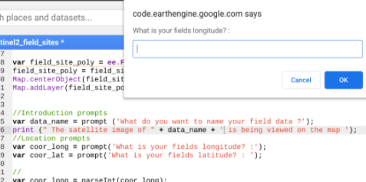
Implementation of Subtask 3.2
The first functionality of the application would be for the user to specify the location that they would like to be shown on the map.

Slide 28
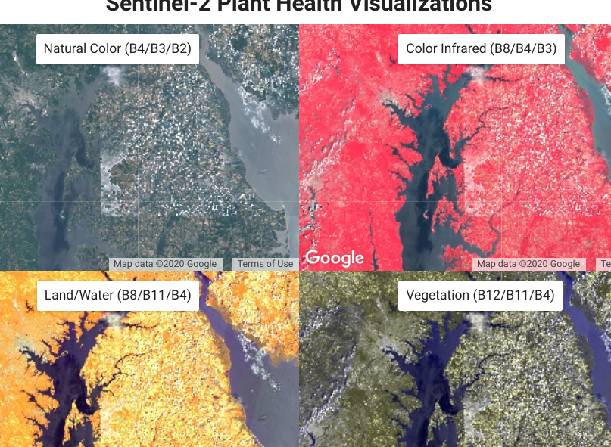
Implementation of Subtask 3.3
The original design feature was for the application to capture the satellite image of a certain location with given coordinates and geometry of area.
New ui libraries in Earth Engine allow for a more interactive experience so a different approach for task 3.3 was underway using the link map functionality.

Slide 29
Next Steps in Implementation
Task 2 is the next major step in achieving the design requirements for the application. [Machine Learning algorithm]
USDA researchers implemented an algorithm that predicted biomass and % of nitrogen in hyperspectral drone images.
Model achieved around 83% accuracy and the architecture of the algorithm was permitted to be altered for this design.
-In this design, a larger area of effect using satellite images vs drone images is predicted to translate to a more generalizable model
- proposed ML algorithm will be a random forest regression model
A supervised learning algorithm that randomly creates and merges multiple decision trees into one forest.

Slide 30

Decision Tree in Machine Learning
A decision tree is a flow-chart-like structure, where each internal (non-leaf) node denotes a test on an attribute, each branch represents the outcome of a test, and each leaf (or terminal) node holds a class label.

Slide 31
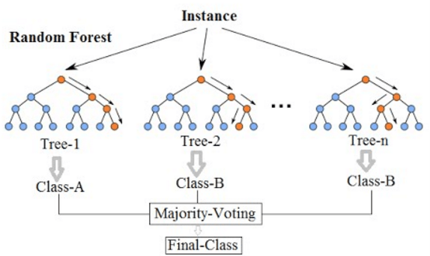
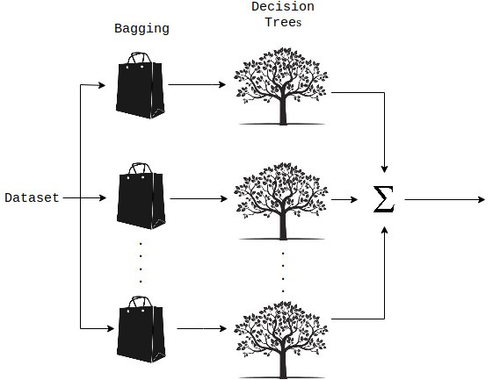
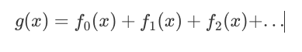
Random Decision Forests
It is an ensemble tree-based learning algorithm. It aggregates the votes from different decision trees to decide the final class of the test object.
Ensemble algorithms are those which combines more than one algorithms of same or different kind for classifying objects.
Each decision tree will be trained on an individual band value.

Slide 32
Next Steps in Implementation
The machine Learning model training is dependent upon obtaining the accurate (x) and (y) inputs of a dataset to produce a viable outcome.
Progress in training model is halted by current inaccuracy of the (y) dataset.

